Slide 1



GENETIC DISORDERS
UNIVERSITY INSTITUTE OF ENGINEERING
Academic Unit V
Bachelor of Engineering
(Computer Science & Engineering)
Biology For Engineers
23SZT-148
GENETIC DISORDERS
DISCOVER . LEARN . EMPOWER

Slide 2
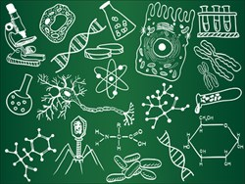
Course Objective
This subject is designed to impart fundamental knowledge on basic and emerging fields of biology like bioinformatics.
It is designed to impart knowledge that how to apply basics of biology in engineering.
https://www.basicknowledge101.com/photos/2016/biology_sketches.jpg

Slide 3
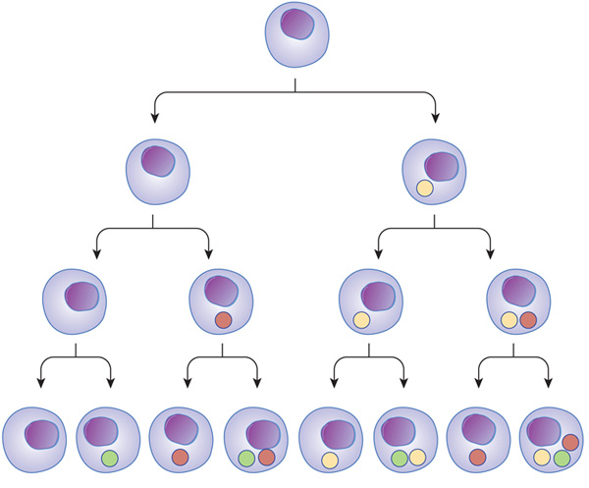
Course Outcome
CO Number | Title | Level
CO1 | Identify the biological concepts from an engineering perspective. | knowledge
CO2 | Development of artificial systems mimicking human action. | Understand
CO3 | Explain the basic of genetics that helps to identify and formulate problems | Analyze
CO4 | Apply knowledge of measurement system, biomedical recording system and biosensors to excel in areas such as entrepreneurship, medicine, government, and education. | Apply
CO5 | Integrate biological principles for developing next generation technologies, | Create
Will be covered in this lecture
https://www.nature.com/scitable/content/ne0000/ne0000/ne0000/ne0000/14707620/U2CP3-4B_RegulProteinsLoop_ksm.jpg

Slide 4
SYLLABUS
Unit-1 | Importance of Biology In Engineering | Contact Hours: 15
Chapter 1 Significance of Biology in Engineering Chapter 2 Genetics | Introduction: Fundamental Differences between Science and engineering by drawing a comparison between eye and camera, Bird flying and aircraft. Significance of Biology in Engineering, Discuss how biological observations of 18th Century that lead to major discoveries, Examples from Brownian motion and the origin of thermodynamics by referring to the original observation of Robert and Julius Mayor. Genetics: Mendel’s laws, Concept of segregation and independent assortment, concept of allele, gene mapping, Gene interaction, Epitasis, Meiosis and Mitosis as a part of genetics. Mechanism of how genetic material passes from parent to offspring. Concepts of recessiveness and dominance. Concept of mapping of phenotype to Genes, single gene disorders in humans, concept of complementation using human genetics.

Slide 5
Sex determination and Sex chromosome
Sex chromosome, either of a pair of chromosomes that determine whether an individual is male or female. The sex chromosomes of human beings and other mammals are designated by scientists as X and Y.
In humans the sex chromosomes consist of one pair of the total of 23 pairs of chromosomes. The other 22 pairs of chromosomes are called autosomes.

Slide 6
Sex determination and Sex chromosome
Individuals having two X chromosomes (XX) are female; individuals having one X chromosome and one Y chromosome (XY) are male.
The X chromosome resembles a large autosomal chromosome with a long and a short arm. The Y chromosome has one long arm and a very short second arm.
This path to maleness or femaleness originates at the moment of meiosis, when a cell divides to produce gametes, or sex cells having half the normal number of chromosomes.

Slide 7
Sex determination and Sex chromosome
During meiosis the male XY sex-chromosome pair separates and passes on an X or a Y to separate gametes; the result is that one-half of the gametes (sperm) that are formed contains the X chromosome and the other half contains the Y chromosome.
The female has two X chromosomes, and all female egg cells normally carry a single X.
The eggs fertilized by X-bearing sperm become females (XX), whereas those fertilized by Y-bearing sperm become males (XY).

Slide 8
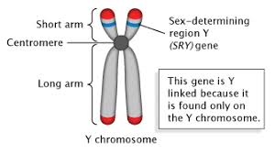
Sex determination and Sex chromosome
The effects of genes carried only on the Y chromosome are, of course, expressed only in males.
Most of these genes are the so-called maleness determiners, which are necessary for development of the testes in the fetus.

Slide 9
Genetic disorders
An inherited medical condition caused by a DNA abnormality.
A genetic disorder is a disease that is caused by a change, or mutation, in an individual's DNA sequence. A genetic disorder is an illness caused by changes in a person's DNA.
Genetic disorders can be caused by a mutation in one gene (monogenic disorder), by mutations in multiple genes (multifactorial inheritance disorder), by a combination of gene mutations and environmental factors, or by damage to chromosomes (changes in the number or structure of entire chromosomes)

Slide 10
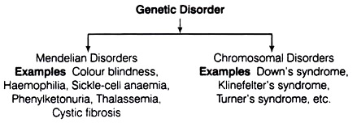

Slide 11
Mendelian Disorders:
These are mainly determined by alteration or mutation in the single gene. These disorders are transmitted in next generation according to the principle of inheritance and can be studied by pedigree analysis. These can be dominant or recessive.
For example,
Autosomal dominant disorder are Osteogenesis imperfecta, Polycystic kidney disease, Huntington’s Disease, Fatal familial Insomnia, etc.
Autosomal recessive disorder are Sickle cell anaemia, cystic fibrosis, Xeroderma pigmentosum, Albinism etc.

Slide 12
Haemophilia:
It is a sex-linked recessive disease, which is transmitted from an unaffected carrier female to some of the male offsprings. Due to this, patient continues bleeding even on a minor injury because of defective blood coagulation. The gene for haemophilia is located on X-chromosome. The defective alleles produce non-functional proteins, which later form a non-functional cascade of proteins involved in blood clotting.
The possibility of a female becoming a haemophilic is extremely rare because mother of such a female has to be at-least carrier and father should be haemophilic.
For example, females suffer from this disease only in homozygous condition, i.e., X^{C}X^{C}. Queen Victoria was a carrier of haemophilia and produced haemophilic individuals.

Slide 13
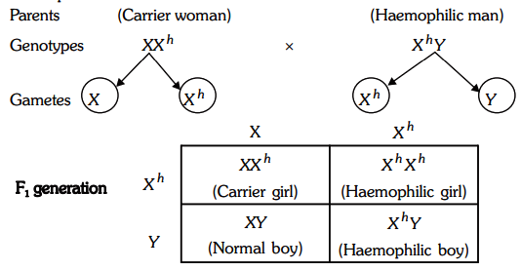

Slide 14
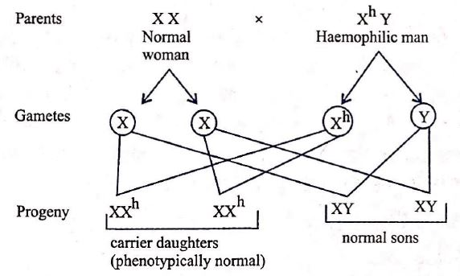

Slide 15
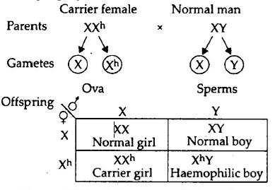

Slide 16
Colour Blindness
It is a sex-linked recessive disorder, which results in defect in either red or green cone of eye. It does not mean not seeing any colour at all, in-fact it leads to the failure in discrimination between red and green colour. The gene for colour blindness is present on X-chromosome.
It is more present in males (X^{C}Y) because of the presence of only one X-chromosome as compared to two chromosomes in females.
A heterozygous female has normal vision, but is a carrier and passes on the disorder to some of her sons. Colour blindness like any other inheritance show crisscross inheritance.

Slide 17
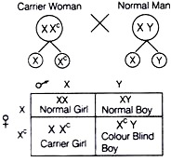
Example

Slide 18
Sickle-Cell Anaemia
It is a genetic disease of human beings. This disease is caused by a recessive gene Hb^{s}.
The normal gene Hb^{A} present on chromosome 11 has undergone mutation to produce the recessive Hb^{s} gene which cause sickle-cell anaemia in homozygous condition (Hb^{s} Hb^{s}) and the patient dies.
In heterozygous condition (Hb^{A} Hb^{s}) the patient survives, only few R.B.Cs are affected.
The R.B.Cs in this disease become sickle-shaped in venous blood owing to the lower concentration of oxygen. This causes rupture of cells and severe haemolytic anaemia.

Slide 19
Haemoglobin is a conjugate protein of heme and globulin. It is formed of about 600 amino acids, two identical α chains and two identical β chains. The sixth amino acid in chain of normal haemoglobin is glutamic acid.
In sickle-cell haemoglobin glutamic acid is replaced by valine. The children homozygous for sickle-cell gene (Hb^{s}Hb^{s}) produce rigid chains. When oxygen level of blood drops below certain level, R.B.Cs undergo sickling.

Slide 20
Such cells do not transport oxygen efficiently they are removed by spleen causing severe anaemia.
Individuals with Hb^{A}Hb^{A} genotype are normal, those with Hb^{s}Hb^{s} genotype have sickle-cell disease and those with Hb^{A}HB^{s} geno-type have the sickle-cell trait.
Two individual with sickle-cell trait can produce children with all three phenotypes. Individuals of sickle-cell trait are immune to malaria.

Slide 21
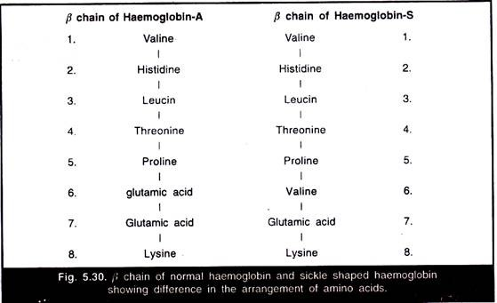

Slide 22
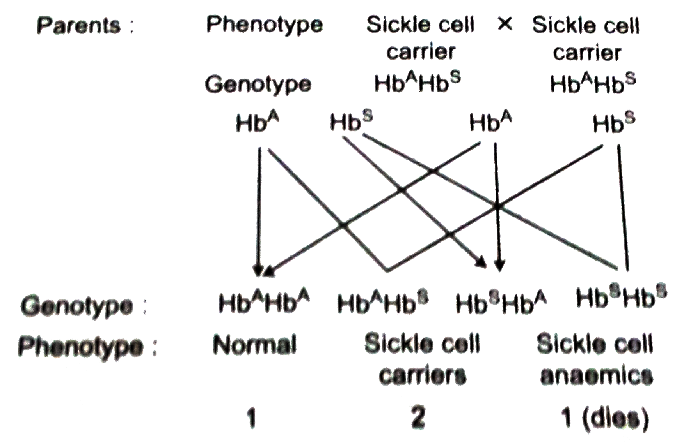
Example

Slide 23
Phenylketonuria (PKU):
This genetic disease was discovered by the Norwegian physician A. Foiling in 1934.
It is a single gene disorder caused by the mutation (= change) of a gene on chromosome 12.
PKU results when there is deficiency of liver enzyme phenylalanine hydroxylase which converts phenylalanine (an amino acid) into tyrosine (amino acid).
Thus, there is high level of phenyl alanine in the blood and tissue fluid of the patient causing disease.

Slide 24
Lack of enzyme phenyl alanine hydroxylase (an inborn metabolic disorder) is due to the homozygous recessive gene.
Affected babies are normal at birth but within a few weeks there is rise in plasma phenylalanine level which damages the development of brain.
Generally by six months severe mental retardation is observed.
If these affected children are not treated properly one third of them are unable to walk and two-thirds cannot talk.

Slide 25
Besides mental retardation other symptoms of the disease include decreased pigmentation of hair and skin and eczema.
Large amount of phenylalanine and its metabolites although excreted through urine and sweat, their excess accumulation damages the brain. The heterozygous individuals are normal but carriers.

Slide 26
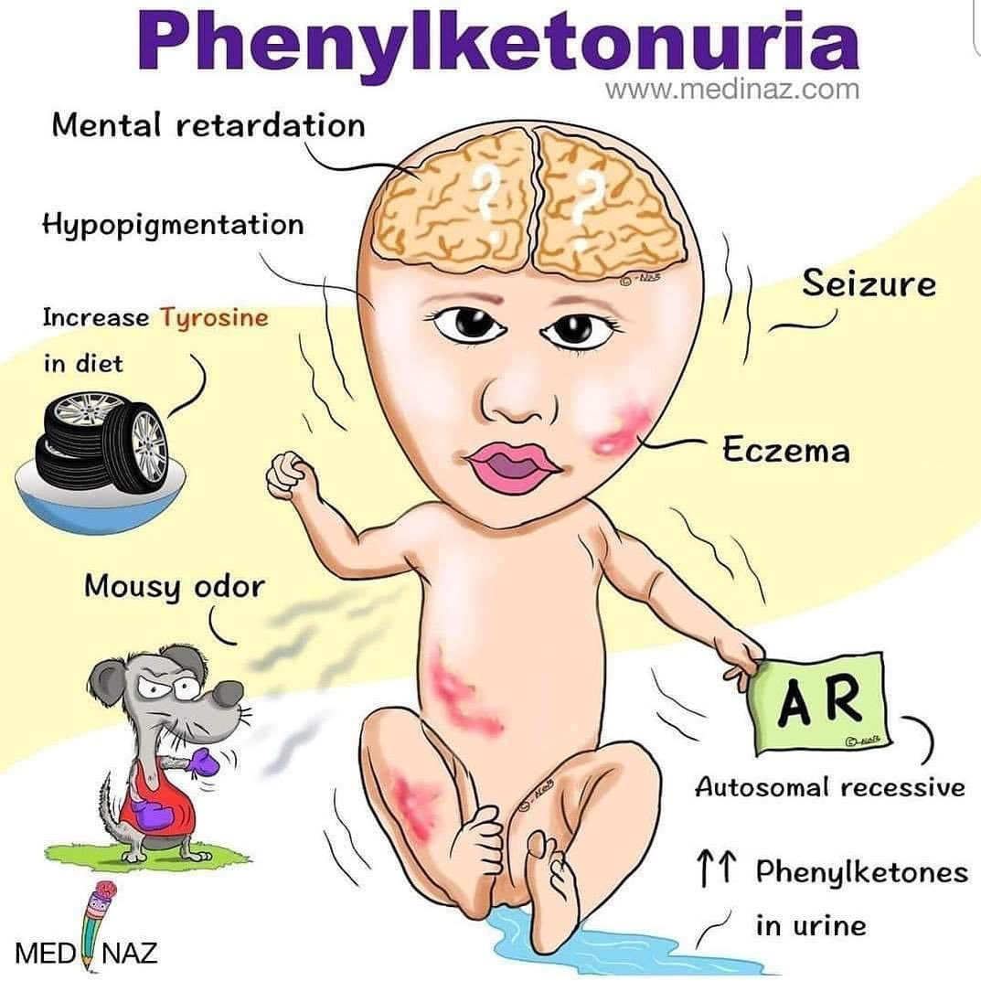

Slide 27
Thalassemia:
It is an autosome-linked recessive disease, which occurs due to either mutation or deletion, resulting in reduced rate of synthesis of one of the globin chains of haemoglobin. Anaemia is the main feature of this disease.

Slide 28
Thalassemia is a genetic disorder in which there is decreased production of one of the globin chains found in hemoglobin. This oxygen-transporting molecule in blood normally contains four globin chains, two alpha (a) and two non-a, each with its own heme group (made of an iron atom bound in protoporphyrin ring).

Slide 29
Thalassemia is classified into three types on the basis of globin chain affected:
(i) Alpha (α) Thalassemia:
It is controlled by the closely linked genes HBA1 and HBA2 on chromosome. In this, the production of globin gene is affected due to the mutation or deletion of one or more alleles.

Slide 30
(ii) Beta (β) Thalassemia:
It is controlled by a single gene HBB on chromosome. It occurs due to the mutation in one or both the alleles of the gene. Hence, there is a reduced synthesis of beta globin of haemoglobin.
In sickle cell disease, an abnormal hemoglobin protein (i.e., hemoglobin S) is made, but it doesn't function correctly; however, in beta thalassemia, the mutation in HBB results in less hemoglobin protein being made. There are actually several types of alpha and beta thalassemia, each with varying severity of symptoms

Slide 31
CHROMOSOMAL DISORDER
A chromosomal disorder occurs when there is a change in the number or structure of the chromosomes.
All abnormalities result from an error during meiosis, called “nondisjunction”
The problem arises when during meiosis there is a failure of homologous chromosomes to separate.
This change in the amount, or arrangement of the genetic information in the cells may result in problems in growth, development and/or functioning of the body systems.

Slide 32
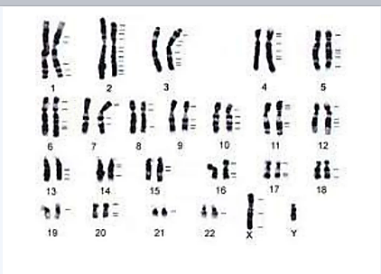
Karyotypes
Karyotypes means photograph of one’s chromosomes, grouped in pairs of homologous chromosomes by size.
Humans have 1 pair of sex chromosomes (XX or XY) and 22 pairs of autosomes (chromosomes that are not sex chromosomes).
This is a normal karyotype of human chromosomes

Slide 33
Karyotypes DO NOT show
Individual DNA strands or genes or the DNA sequence
The number of genes in a chromosome
The presence of gene mutations

Slide 34
Chromosome Disorders caused by Nondisjunction
Down syndrome (trisomy 21)
Turners syndrome (monosomy XO)
Edwards syndrome (trisomy 18)
Klinefelters syndrome (trisomy XXY)
XYY syndrome (trisomy XYY)
XXX syndrome (trisomy X)

Slide 35
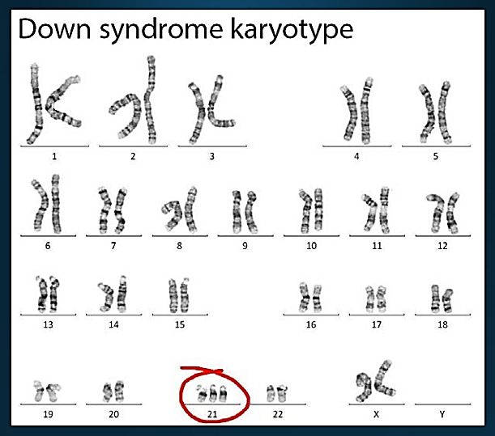
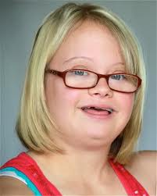
Down Syndrome
Extra copy of chromosome 21. Also called “Trisomy 21”
1 in 1250 births
47 chromosomes
#21 trisomy nondisjunction
Short, broad hands
Rough skin
Impotency in males
Mentally retarded
Small round face
Short lifespan

Slide 36
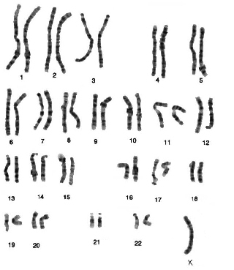
Turners Syndrome
1 in 5000 births
45 chromosomes, X only (XO Females)
#23 Monosomy nondisjunction
Missing 2nd sex chromosome.
  This is the only monosomy in which the embryo survives.
  If any other chromosomes are missing then embryo/fetus does not survive.
Sterile
96-98% do not survive to birth

Slide 37
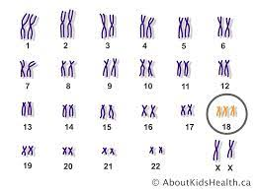
Edwards syndrome
#18 Trisomy
Half of those born don’t survive past 1st week
Unusually small head
Mouth and jaw are small
Hands are clenched into fists
Congenital heart defects
Growth Retardation

Slide 38
#23 Trisomy or Sex Chromosome Trisomy
Trisomy of the sex chromosomes
47 Chromosomes
Klinefelters syndrome (trisomy XXY)
XYY syndrome (trisomy XYY)
XXX syndrome (trisomy X)

Slide 39
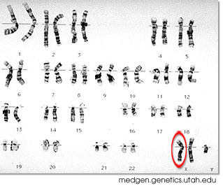
Klinefelter Syndrome
1 in 1100 births
XXY- Males
#23 trisomy nondisjunction
Taller than average
Longer fingers and arms
Sterile
Low testosterone
Delicate skin
Low mental ability
Normal lifespan
Often don’t know they have it unless tested.

Slide 40
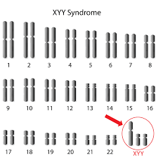
XYY Syndrome
Males with extra Y (Supermales)
47 chromosomes
Taller than average (above 6 Feet)
High level of testosterone
Severe acne
Poorly coordinated
Normal development – never know they have it unless tested.
May have sterility problems

Slide 41
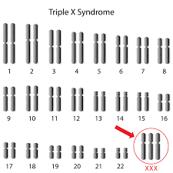
XXX Syndrome
Females with extra X
47 chromosomes
Taller than average
Often develop normally – never know they have it unless tested.
May have sterility problems

Slide 42
REFERENCES
Gupta, P.K.. Cytology, Genetics and Molecular Biology, Rastogi Publishers, Meerut, 1993
Singh B.D. 2007. Fundamentals of Genetics. Kalyani Publishers
C.B.Powar.2010 .Cell Biology VOL I. Himalaya Publishing House.
Robert Weaver. 2012 “Molecular Biology,” 5th Edition, MCGraw-Hill.
https://learn.genetics.utah.edu/content/basics/mutation/
https://en.wikipedia.org/wiki/Cell_division#:~:text=Cell%20division%20is%20the%20process,of%20a%20larger%20cell%20cycle
https://www.khanacademy.org/science/biology/cellular-molecular-biology
https://www.youtube.com/watch?v=NFdeXi9Gfpc
http://www.digimat.in/nptel/courses/video/121106008/L13.html
https://youtu.be/xsrH050wnIA

Slide 43

THANK YOU

